Slide 1
Build an RDSH App and Desktop Virtualization Environment in Amazon AWS
June 2016
Notes:
Ericom Automation framework
Each value is based on the lower one

Slide 2
Automation
PowerShell based – get the power of both C# and the popular IT community scripts
Easy to customize
Easy to monitor

Slide 3
Automation – Remote Desktop Session Host
Remote Desktop Session Host setup
Check Prerequisite ( Domain, DNS)
Install the needed Windows features
Configure Windows (Firewall, RDP settings, Join Domain)
Add to the Broker
Install application and publish them as Remote Apps

Slide 4
Automation – Connection broker
Connection Broker setup
Check Prerequisite ( Domain, DNS)
Install the needed Windows features
Install the license server
Configure Windows (Firewall, RDP settings, Join Domain)

Slide 5
Automation – Bonus
Get list of MSI product info - Get-GUIDFromMSIs.ps1
Join domain – JoinMachineToDomain.ps1
Create AD and domain – DomainController.ps1
PowerShell UI ?
Monitoring using script

Slide 6
The Cloud Challenge
In the Cloud world
Costs are the most important aspect, keeping them low is a first priority
Agility is a must - customers will not wait for anything
Cloud Providers
Need to perform many operations for each customer, during both the on-boarding process and during the day to day management
Strive to differentiate themselves preferably with off-the-shelf products, while still cater to specific customer demands

Slide 7
RDS in AWS : solution components
Agility
Cost savings
User experience
Customization
Automation
Connection Brokering
Microsoft RDS
AWS infrastructure

Slide 8
AWS environment
Notes:
https://aws.amazon.com/windows/resources/whitepapers/rdgateway/

Slide 9
Microsoft RDS vs VDI
Topic | RDS | VDI
Ease of Operation | Quick installation within minimal prep No client installation Minimal IT daily management | Require a dedicated environment Requires an image installation Requires daily IT management
Cost | One time $100 Microsoft CAL Higher ratio of users per server (concurrent) Usage of inexpensive and aged devices Concurrent licensing Resources provided on-demand | Annual $100 Microsoft VDA One system per users (full OS and apps) Devices should handle OS & Apps Licensing per device Resources are pre-allocated
Scalability | Better suited for a distributed/global org Easily supports 3rd party and BYOD | Requires a datacenter in each location Harder to support BYOD

Slide 10
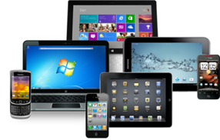

Connection Broker
End-User
Connection Broker
Server Farm
Load Balancing
User Authentication
Resource Allocation
Tracking and Auditing
Simple use cases might get alone with RDS
Advanced use cases like multi tenancy will require a 3rd party
Notes:
10
10
A Connection Broker is a software program that allows the end-user to connect to an available desktop
It allows multiple software clients to access various types of server-hosted desktops and applications (1 broker serves multiple end-users)
It is the “middle” component between the end user and the server

Slide 11
Automation
Automation enables to perform complex and tedious operations in a consistent and efficient manner
Automation extends the RDS functionality and eases the path to use it in a cloud environment
Automation of deployment allows the creation of tenants or even complete systems with a single click

Slide 12
Customization

Slide 13

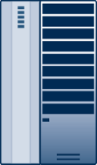

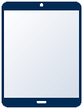



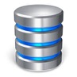
RDS Logical Architecture Multi-Tenancy
Tenant A
Terminal Server
Clients
Gateway
(optional)
Connection Broker
Desktops
Single User Server
Mobile
Terminal Server for Desktops
Broswers
Terminal
For Apps
Admin
Database
Tenant B
Notes:
Generally speaking, having a dedicated machine just for secure browsing, without anything else, is probably the best thing. However, not realistic

Slide 14
Automation

Slide 15
Automation
AWS automation
Windows configuration automation System Deployment automation
User provision automation
Application installation automation
Managing configuration drifts
Health Monitoring and alerting

Slide 16
The Cloud Experience

Slide 17
New Company Account Creation
Customer admin registers to system and creates a new company account (tenant)
Provides company info including 3rd party billing platform to handle user payment and authorization
Once the user parameters are registered, they are passed to the Ericom Connect Automation Script
The customer will receive a mail with the links that he needs to provide for his users
Notes:
Enter user credentials. The user will be added to the Active Directory
Select the relevant package or customize the required desktop components. The relevant resources will be associated with the user
The user gets an e-mail and a link to access the personalized desktop

Slide 18
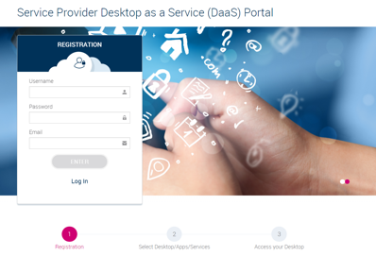
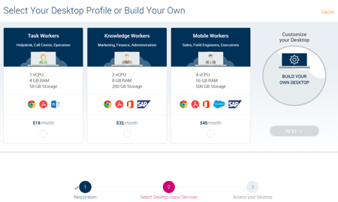
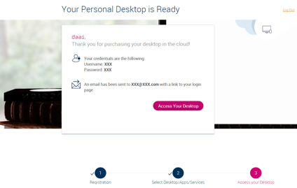
The User Experience – Cloud in 1,2,3…
Register
Select
Access
End users will receive from their admin a link to register and connect to their desktop
Notes:
Enter user credentials. The user will be added to the Active Directory
Select the relevant package or customize the required desktop components. The relevant resources will be associated with the user
The user gets an e-mail and a link to access the personalized desktop

Slide 19
Backend workflow
Intro
End User receives a link from the Admin to access an introduction page to begin
Two options are typically available: Create New or Login
Automation creates the users in AD if needed
Login
User receives an email with login data
User can login to Desktop and optional applications as well.
Management
All activity data is logged into the SQL database
Provider can add resources to the system according to end users need
Publish
Register
A new customer Admin creates an account for his users
Billing information is set
Automation configures the system for the user

Slide 20
Detailed Info on Cloud Steps

Slide 21
Register
This step registers and configures a new Company on the system
The customer will receive a mail with the links that he needs to provide for his users
Register.ps1
function Register {
CreateTennatUserEC;
ConfigureAD;
CreateVMForTennat
ConfigureBilling
SendMail
}
Notes:
Enter user credentials. The user will be added to the Active Directory
Select the relevant package or customize the required desktop components. The relevant resources will be associated with the user
The user gets an e-mail and a link to access the personalized desktop

Slide 22

Cloud Portal – Create User/Login
Ericom Automation accepts the parameters and automates the provisioning of the system for the new user
Creates the user in Active Directory and assigns the necessary groups
Creates or assigns a desktop to the user (RDSH or dedicated instance)
Tests the user connection and checks the launch analysis output for validity
Returns status email after completion or failure of the automation

